Slide 1
Software Engineering
Week 02 Lecture 02

Slide 2
Timeline of Methodologies
1950s | Code and Fix
1960s | Design-Code-Test-Maintain
1970s | Waterfall Model
1980s | Spiral Model
1990s | Rapid Application Development, V Model
2000s | Agile Methods

Slide 3
Rapid Application Development
RAD Model is a software development process based on prototyping without any specific planning.
Flexible and adaptable.
Allows developers to quickly respond to changes in requirements and design specifications.

Slide 4
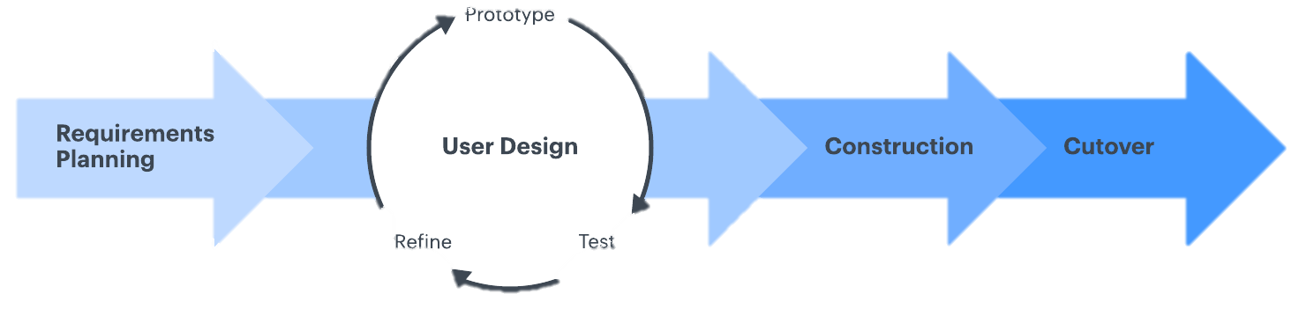
Rapid Application Development

Slide 5
Phases of RAD
Requirements Planning
Rapid Prototyping/ Designing
Iterative Development/ Construction
Deployment/Cutover

Slide 6
Requirements Planning
Combines Planning and Analysis from Waterfall model
The project team identifies the project requirements, constraints, and objectives.
This includes gathering information from stakeholders, identifying project risks, and establishing a project plan.
Notes:
End users and IT staff agree on business needs, project scope, constraints, and system requirements.

Slide 7
Designing
The team creates a working prototype of the software application (system processes, inputs, outputs)
This prototype is used to validate the design, identify potential issues, and gather feedback from stakeholders.
It needs to be a continuous interactive process.
Notes:
Continuous interactive process that allows the end users to understand, modify and eventually approve a model of system that meet their needs

Slide 8
Development / Construction
Team uses feedback from stakeholders to refine and improve the software application.
This involves multiple iterations of development, testing, and refinement until the software meets the desired functionality and quality.
Notes:
Key tasks in this phase are programming and app development, coding, unit integration and system testing.

Slide 9
Deployment/Cutover
Team deploys the software application to the end-users.
This includes installation, training, and support.
Notes:
Compared to traditional methods, the entire process is compressed and as a result, the new system is built, delivered and placed in operation much sooner.

Slide 10
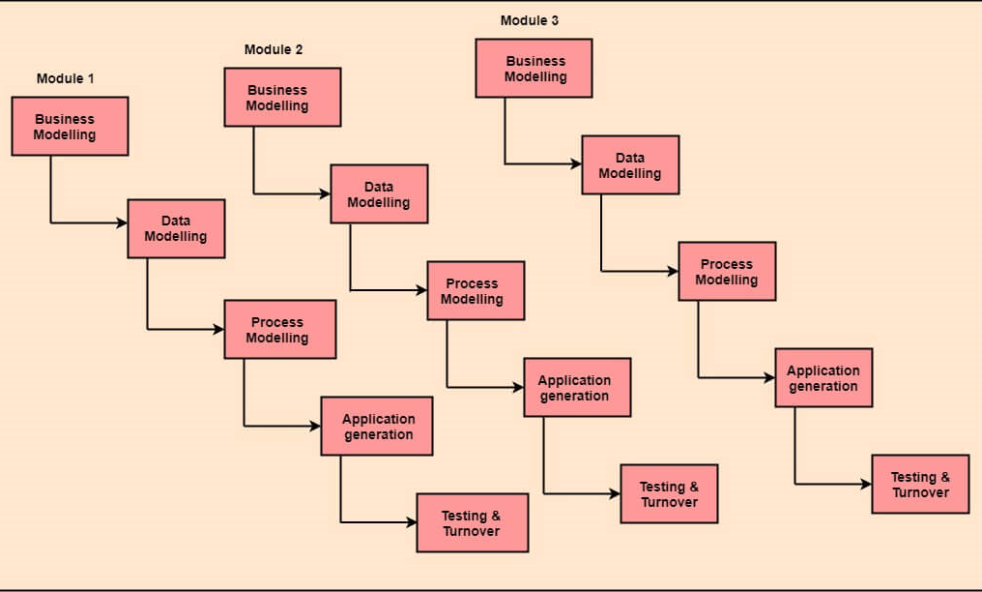
Other Version

Slide 11
Business Model
Describes the organization's goals, objectives, and processes.
Identifies the key stakeholders, their roles, and the interactions between them.
To ensure that the software application aligns with the organization's overall strategy and objectives.

Slide 12
Data Model
Describes the structure of the data that is used by the software application.
Identifies the data entities, attributes, and relationships between them.
To ensure that the software application can effectively manage and manipulate the data that it uses.

Slide 13
Process Model
Describes the workflow or business processes that the software application will support.
Identifies the different steps in the process, the inputs and outputs at each step, and the business rules that govern the process.
To ensure that the software application can effectively support the organization's key business processes.

Slide 14
Methodology
The most effective family of techniques must be formalized and used to deliver the system
A complete list of tasks is provided.
Techniques are fully documented.
Notes:
2- to ensure no essential activity is overlooked.
3- to ensure that task is performed in a proper way.

Slide 15
People
The best people must be well-trained in both the methodology and tools.
Small teams that work consistently well together should be grouped together on assignments.

Slide 16
Management
Project must be managed for speed using techniques such as Joint Requirement Planning (JPR) and Joint Application Design (JAD).
Timebox Management is used in rapid construction to iteratively deliver the system to users
Notes:
Technique that involves setting a fixed time period, or "time box," for a specific activity or task.

Slide 17
Advantages of RAD
Significantly reduced development time.
Increases reusability of components
Quick initial reviews.
Encourage customer feedback
Integration from very beginning solves a lot of integration issues

Slide 18
Disadvantages of RAD
Depends on strong team and individual performances of identifying business requirements.
High dependency on modelling skills
Inapplicable to cheaper projects
Notes:
3- as cost of modelling and automated code generation is very high

Slide 19
When to use RAD
If there’s high availability of designers for modelling
If budget is high
If resources with high business knowledge are available.
Notes:
2- cost of modelling and automated code generation is very high
3- They need to produce the system in short span of time 2-3 months

Slide 20
WHAT HAVE YOU LEARNT IN THIS CLASS
Rapid Application Development
Phases of RAD
Advantages of RAD
Disadvantages of RAD
When to use RAD

